Slide 1
Calculating theoretical probabilities from a table (one event)
Probability: theoretical probabilities

Slide 2
How our teaching resources are designed for the classroom

Slide 3
I can find theoretical probabilities from a table showing the possible outcomes for one event.

Slide 4
The probability that an event will occur is the proportion of times the event is expected to happen in a suitably large experiment.
A theoretical probability is a probability based on counting the number of desired outcomes from a sample space where all individual outcomes are equally likely.
The frequency is the number of times an event occurs; or the number of individuals (people, animals, etc) with some specific property.

Slide 5

Calculating theoretical probabilities from a table (one event)
Finding probabilities from a frequency table
Finding probabilities from an outcome table

Slide 6


Finding probabilities from a frequency table
Alex has a box of novelty flavoured sweets. Some flavours taste nice, but some flavours have been manufactured to taste nasty as a joke.
The flavours of the sweets are shown in the table.
tasty flavours | nasty flavours
strawberry
grass
caramel
earwax
toffee
fish
fudge
garlic
orange
chocolate

Slide 7


Finding probabilities from a frequency table
Alex puts one of each flavour into a bag.
He offers a sweet to Izzy.
What is the probability that she picks a nasty flavour?
tasty flavours | nasty flavours
strawberry
grass
caramel
earwax
toffee
fish
fudge
garlic
number of nasty sweets
orange
P(nasty flavour) =
chocolate
total number of sweets

Slide 8


Finding probabilities from a frequency table
The table shows how many of each flavour sweet is in the entire box.
flavour | frequency
strawberry | 11
caramel | 10
toffee | 8
fudge | 12
orange | 8
chocolate | 9
grass | 8
earwax | 3
fish | 5
garlic | 6
total | 80
What is the probability of randomly choosing a fudge flavour sweet?
number of fudge sweets
P(fudge) =
total number of sweets
This probability could also be written as 0.15, 15% or .

Slide 9

Finding probabilities from a frequency table
The table shows how many of each flavour sweet is in the entire box.
flavour | frequency
strawberry | 11
caramel | 10
toffee | 8
fudge | 12
orange | 8
chocolate | 9
grass | 8
earwax | 3
fish | 5
garlic | 6
total | 80
What is the probability of randomly choosing an orange flavour sweet?
number of orange sweets
P(orange) =
total number of sweets

Slide 10

Finding probabilities from a frequency table
The table shows how many of each flavour sweet is in the entire box.
flavour | frequency
strawberry | 11
caramel | 10
toffee | 8
fudge | 12
orange | 8
chocolate | 9
grass | 8
earwax | 3
fish | 5
garlic | 6
total | 80
Izzy’s two favourite flavours are fudge and orange.
What is the probability that she randomly chooses one of these flavours?
sum of fudge and orange
P(fudge or orange) =
total number of sweets

Slide 11

Finding probabilities from a frequency table
The table shows information about pupils on a school trip.
year group | frequency
Year 7 | 8
Year 8 | 6
Year 9 | 10
Year 10 | 7
Year 11 | 9
A pupil is chosen at random for a task.
What is the probability that the pupil chosen is from Year 10?
P(Year 10) =

Slide 12

Finding probabilities from a frequency table
The table shows information about pupils on a school trip.
year group | frequency
Year 7 | 8
Year 8 | 6
Year 9 | 10
Year 10 | 7
Year 11 | 9
A pupil is chosen at random for a task.
What is the probability that the pupil chosen is from Year 7-9?
P(Year 7-9) =

Slide 13
Finding probabilities from a frequency table
1) The table shows the number of sweets of each flavour in a novelty box of sweets.
flavour | frequency
strawberry | 11
caramel | 10
toffee | 8
fudge | 12
orange | 8
chocolate | 9
grass | 8
earwax | 3
fish | 5
garlic | 6
total | 80
a) Find the probabilities for picking each of the following flavours when a sweet is chosen at random.
P(strawberry) =
P(caramel) =
P(toffee) =
P(chocolate) =
P(grass) =
P(earwax) =
P(fish) =
P(garlic) =
b) The nasty flavours are grass, earwax, fish and garlic. What is the probability of choosing a nasty flavoured sweet?

Slide 14
Finding probabilities from a frequency table
2) Sam is carrying out a data investigation about how pupils in a nearby village travel to school. She conducts a survey and records her results in a tally chart.
a) Complete the frequency column of the table.
mode of transport | tally | frequency
car
bus
bicycle
walk
b) To further her investigation, Sam chooses a pupil at random to interview.
i) What is the probability that the person chosen travels by car?
ii) What is the probability that the person chosen travels by bus?
iii) What is the probability that the person chosen travels by bicycle?
iv) What is the probability that the person chosen walks to school?

Slide 15
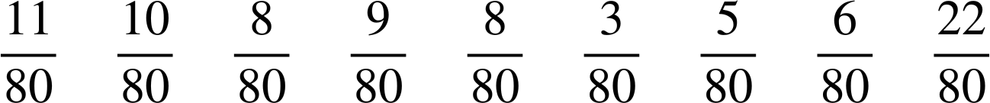
Finding probabilities from a frequency table
1) The table shows the number of sweets of each flavour in a novelty box of sweets.
flavour | frequency
strawberry | 11
caramel | 10
toffee | 8
fudge | 12
orange | 8
chocolate | 9
grass | 8
earwax | 3
fish | 5
garlic | 6
total | 80
a) Find the probabilities for picking each of the following flavours when a sweet is chosen at random.
P(strawberry) =
P(caramel) =
P(toffee) =
P(chocolate) =
P(grass) =
P(earwax) =
P(fish) =
P(garlic) =
b) The nasty flavours are grass, earwax, fish and garlic. What is the probability of choosing a nasty flavoured sweet?

Slide 16
Finding probabilities from a frequency table
2) Sam is carrying out a data investigation about how pupils in a nearby village travel to school. She conducts a survey and records her results in a tally chart.
a) Complete the frequency column of the table.
mode of transport | tally | frequency
car
bus
bicycle
walk
20
12
9
16

Slide 17
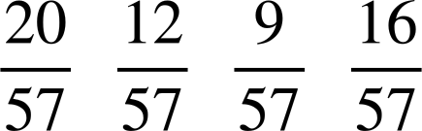
Finding probabilities from a frequency table
b) To further her investigation, Sam chooses a pupil at random to interview.
mode of transport | tally | frequency
car
bus
bicycle
walk
20
12
9
16
i) What is the probability that the person chosen travels by car? ii) What is the probability that the person chosen travels by bus? iii) What is the probability that the person chosen travels by bicycle? iv) What is the probability that the person chosen walks to school?

Slide 18
Calculating theoretical probabilities from a table (one event)
Finding probabilities from a frequency table
Finding probabilities from an outcome table

Slide 19

Finding probabilities from an outcome table
A deck of cards contains the numbers 1 to 10.
The cards could be sorted into odds and evens using a table.
1
2
3
4
5
6
7
8
9
10
odd | even
A card is chosen at random from the deck.
1
3
5
2
4
6
P(odd) =
7
9
8
10
P(even) =

Slide 20
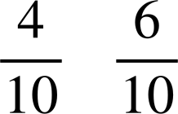
Finding probabilities from an outcome table
The cards could be sorted into primes and not primes using a table.
1
2
3
4
5
6
7
8
9
10
prime | not prime
A card is chosen at random from the deck.
2
3
5
1
4
6
P(prime) =
7
8
9
10
P(not prime) =

Slide 21
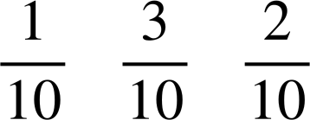
Finding probabilities from an outcome table
The cards could be sorted into odds and evens as well as primes and not primes using a table.
1
2
3
4
5
6
7
8
9
10
A card is chosen at random from the deck.
prime
not prime
P(even prime) =
odd
3
5
7
1
9
P(odd prime) =
even
2
4
6
8
10
P(not prime and odd) =

Slide 22
Finding probabilities from an outcome table
The spinner contains the numbers 1 to 5.
Sort the five outcomes into table below.
factor of 6
not a factor of 6
5
1
even
2
4
4
2
3
odd
1
5
3

Slide 23

Finding probabilities from an outcome table
The spinner is spun once.
What is the probability that it lands on an odd factor of 6?
factor of 6
not a factor of 6
5
1
even
2
4
4
2
3
odd
1
5
3
P(odd factor of 6) =

Slide 24

Finding probabilities from an outcome table
The spinner is spun once.
What is the probability that it lands on an even factor of 6?
factor of 6
not a factor of 6
5
1
even
2
4
4
2
3
odd
1
5
3
P(even factor of 6) =

Slide 25

Finding probabilities from an outcome table
The spinner is spun once.
What is the probability that it lands on a factor of 6?
factor of 6
not a factor of 6
5
1
even
2
4
4
2
3
odd
1
5
3
P(factor of 6) =

Slide 26
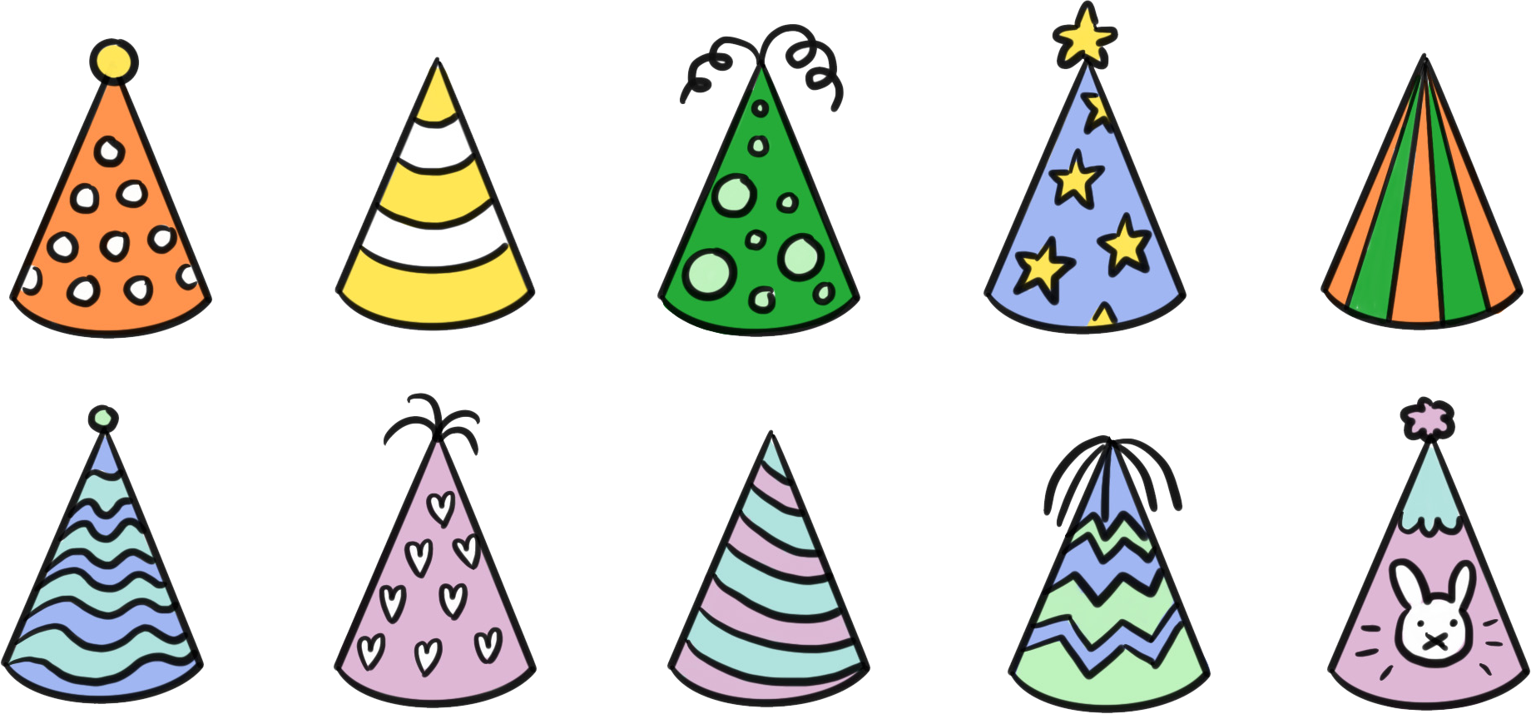
Finding probabilities from an outcome table
1) Party hats from a pack are sorted according to how they are decorated. A hat is chosen at random from the pack.
Find each of the following probabilities.
stripes
no stripes
a) P(stripes and topper) =
topper
b) P(stripes and no topper) =
c) P(no stripes and topper) =
no topper
d) P(no stripes and no topper) =
e) P(stripes) =
f) P(topper) =

Slide 27
Finding probabilities from an outcome table
2) A deck of cards contains the numbers 1 to 20.
a) Sort the numbers 1 to 20 into the table.
multiple of 4
not multiple of 4
b) A card is chosen at random from the deck. Find the probabilities of the following outcomes.
factor of 20
i) P(multiple of 4 and factor of 20)
ii) P(multiple of 4 and not factor of 20)
not factor of 20
iii) P(multiple of 4)
iv) P(not multiple of 4)

Slide 28
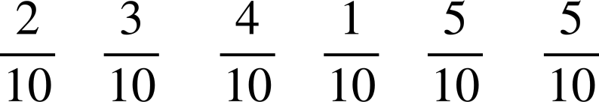
Finding probabilities from an outcome table
1) Party hats from a pack are sorted according to how they are decorated. A hat is chosen at random from the pack.
Find each of the following probabilities.
stripes
no stripes
a) P(stripes and topper) =
topper
b) P(stripes and no topper) =
no topper
c) P(no stripes and topper) =

Slide 29
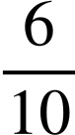
Finding probabilities from an outcome table
1) Party hats from a pack are sorted according to how they are decorated. A hat is chosen at random from the pack.
Find each of the following probabilities.
stripes
no stripes
d) P(no stripes and no topper) =
topper
e) P(stripes) =
no topper
f) P(topper) =

Slide 30
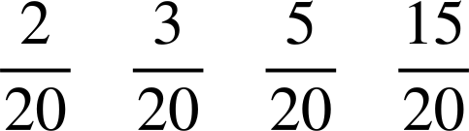
Finding probabilities from an outcome table
2) A deck of cards contains the numbers 1 to 20.
a) Sort the numbers 1 to 20 into the table.
multiple of 4
not multiple of 4
b) A card is chosen at random from the deck. Find the probabilities of the following outcomes.
factor of 20
4, 20
1, 2, 5, 10
i) P(multiple of 4 and factor of 20) =
ii) P(multiple of 4 and not factor of 20) =
not factor of 20
8, 12, 16
3, 6, 7, 9, 11, 13, 14, 15, 17, 18, 19
iii) P(multiple of 4) =
iv) P(not multiple of 4) =

Slide 31
Calculating theoretical probabilities from a table (one event)
The probability of an outcome can be found by considering a frequency table showing all the possible outcomes.
The probability of a set of outcomes can be found from a frequency table by first summing the frequency of those outcomes before calculating the probability.
A table can be used to classify outcomes into sets of outcomes or events.

Slide 32

© Oak National Academy 2024.
Produced in partnership with Mathematics in Education and Industry.
Licensed on the Open Government Licence v3.0, except where otherwise stated. See Oak terms and conditions.

